Slide 1
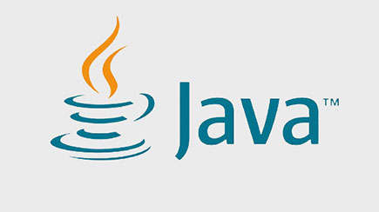
James Gosling
Made by: Ákos Hegedüs

Slide 2
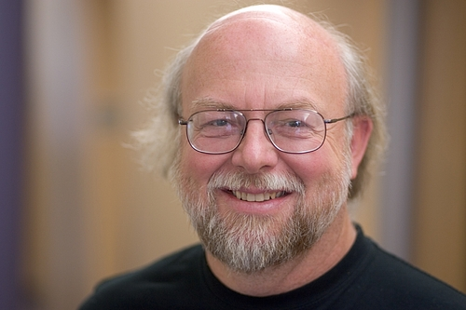
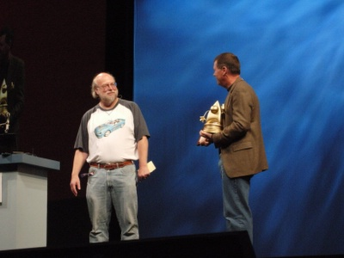
Who is James Gosling
Born: James Arthur Gosling, May 19, 1955, Canada
High School: William Aberhart High School, Calgary, Alberta
University Contribution: Worked at the University of Calgary, developing software for analyzing data from the ISIS 2 satellite.
Education:
B.Sc. degree: University of Calgary
M.A. and Ph.D. in Computer Science: Carnegie Mellon University
Doctoral Work:
Developed Gosling Emacs (Gosmacs)
Built a multiprocessor version of Unix for a 16-way computer system.
Professional Career: Worked at Sun Microsystems, where he developed several compilers and mail systems.
Family: He has two children, Katie and Kelsey, from two marriages.
Notes:
fasz

Slide 3
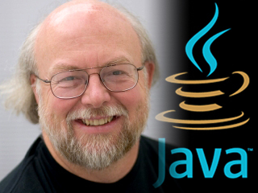
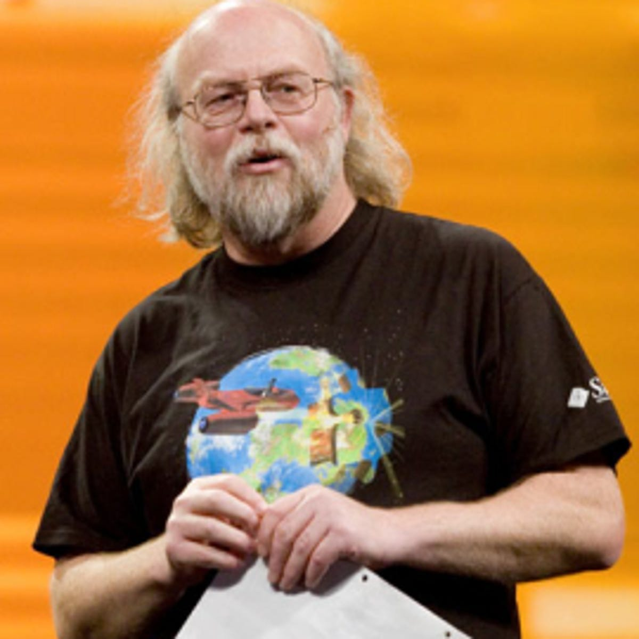
His carrier
Worked at Sun Microsystems from 1984 to 2010.
Invented NeWS, an early Unix windowing system.
Best known as the father of the Java programming language, which he created in 1994.
Developed Java's original design, compiler, and virtual machine.
He Left Sun in 2010 after its acquisition by Oracle, citing ethical concerns and changes in his role.
Later worked at Google.
Joined Liquid Robotics, which was later acquired by Boeing.
Moved to Amazon Web Services as a Distinguished Engineer in 2017.
Retired in July 2024.
Serves as an advisor and board member for several companies.

Slide 4

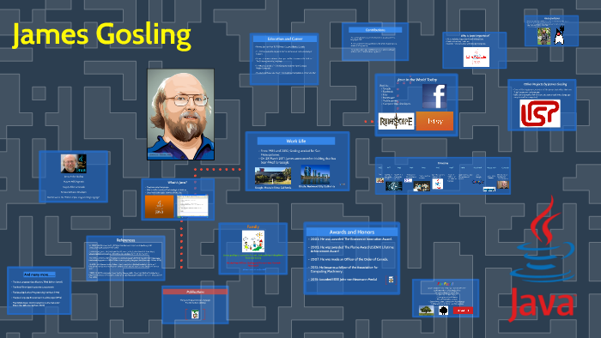
Gosling Emacs
Gosling Emacs (also known as "Gosmacs" or "gmacs") was an early Emacs implementation.
Written in 1981 by James Gosling in C.
Initially, Gosling allowed it to be freely redistributed, following the "Emacs commune" tradition.
After failing to find maintainers for his version, he sold it to UniPress, who agreed to reasonable terms.
This led to a dispute with Richard Stallman.
The dispute inspired the creation of the first formal Emacs license, which later became the GPL (General Public License).
This process followed the introduction of software copyright in 1980.

Slide 5
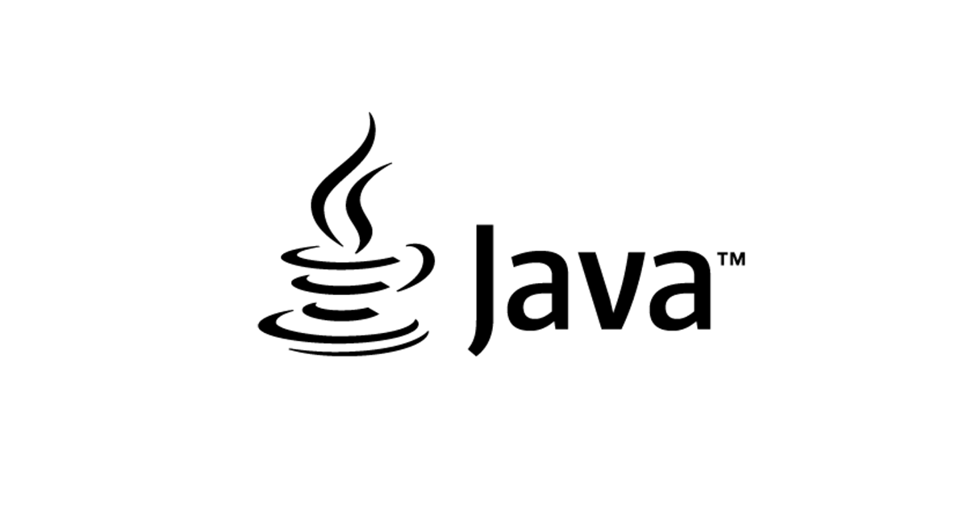
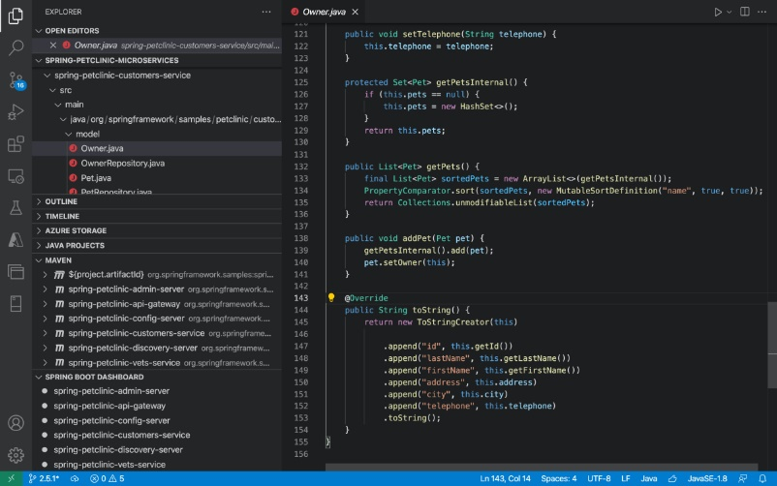
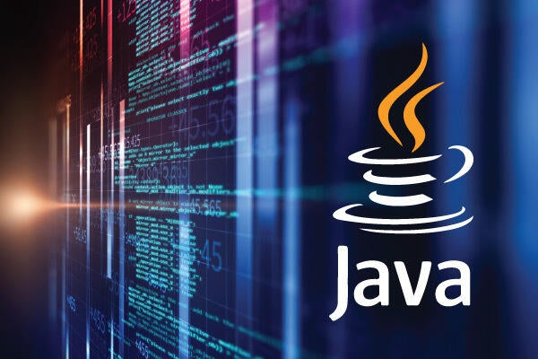
Java
Java is a high-level, object-oriented programming language designed for minimal implementation dependencies.
It follows the "write once, run anywhere" (WORA) principle, allowing compiled Java code to run on any platform with a Java Virtual Machine (JVM).
Syntax is similar to C and C++, but with fewer low-level features.
Java's dynamic capabilities (such as reflection and runtime code
modification) distinguish it from traditional compiled languages.
Originally developed by James Gosling at Sun Microsystems and released in 1995.
Java remains popular, though its use has declined recently in favor of other JVM languages.
The OpenJDK JVM is the official reference implementation.
As of March 2024, Java 22 is the latest version, with previous LTS versions 8, 11, 17, and 21 still supported.

Slide 6
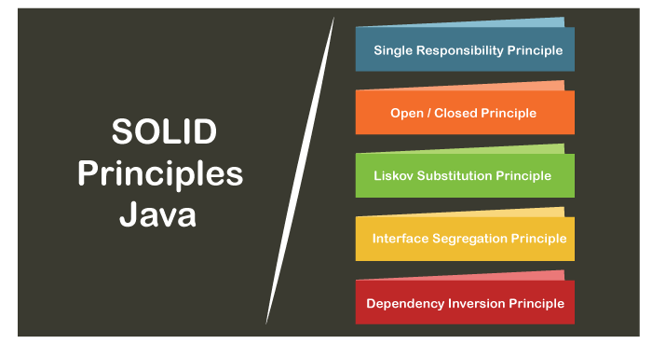
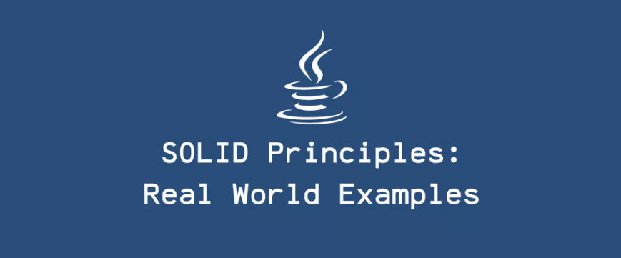
Principles
There were five primary goals in creating the Java language:
1. It must be simple, object-oriented, and familiar.
2. It must be robust and secure.
3. It must be architecture-neutral and portable.
4. It must execute with high performance.
5. It must be interpreted, threaded, and dynamic.

Slide 7
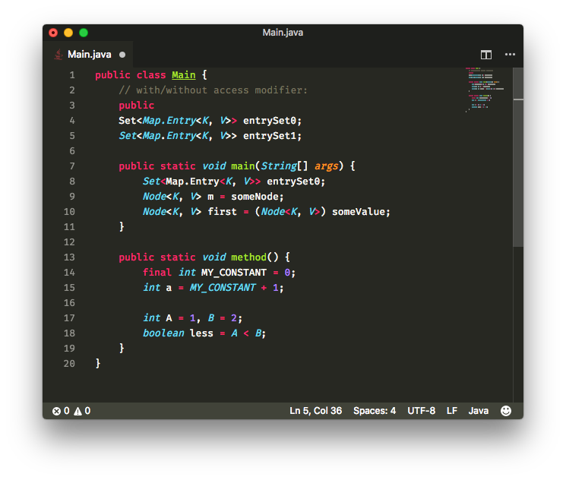
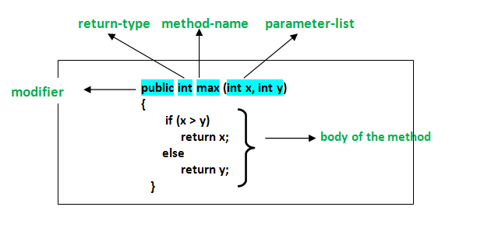
Syntax
Java's syntax is very similar to C++ and C, but it is exclusively object-oriented.
All code is in classes, and all data is an object, except for primitive data types (e.g., integers, floating-point numbers, logical values, characters).
Elements carried over from C++ include the printf method.
Java does not support operator overloading and multiple inheritance of classes (except through interfaces).
It uses three comment formats:
Single-line (//)
Multi-line (/* */)
Javadoc (/** */), which can be used to generate documentation.

Slide 8
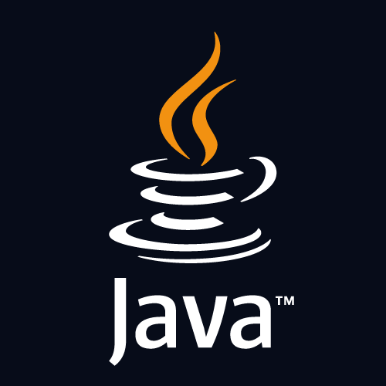
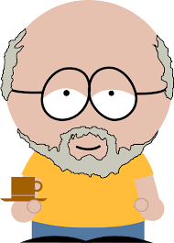
Thank for your attention!
Resources: Wikipedia

